Slide 1
Constructing ALU
(Arithmetic Logic Unit)
Copyright © 2014 Elsevier Inc. All rights reserved.

Slide 2
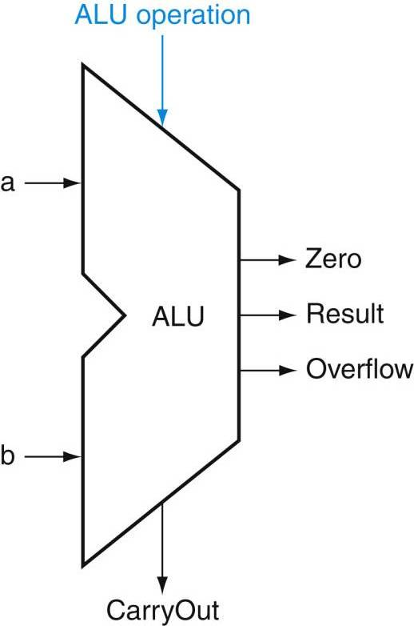
?
?
2
Copyright © 2014 Elsevier Inc. All rights reserved.

Slide 3

FIGURE B.2.1 Standard drawing for an AND gate, OR gate, and an inverter, shown from left to right. The signals to the left of each symbol are the inputs, while the output appears on the right. The AND and OR gates both have two inputs. Inverters have a single input.
Copyright © 2014 Elsevier Inc. All rights reserved.

Slide 4
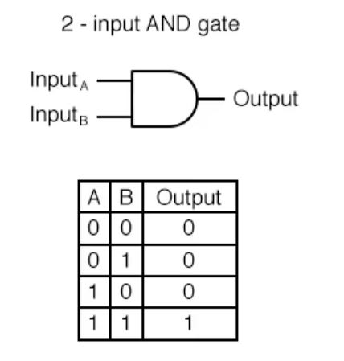
Copyright © 2014 Elsevier Inc. All rights reserved.

Slide 5
A
A
S =
1
A
0
S =
0
Copyright © 2014 Elsevier Inc. All rights reserved.

Slide 6
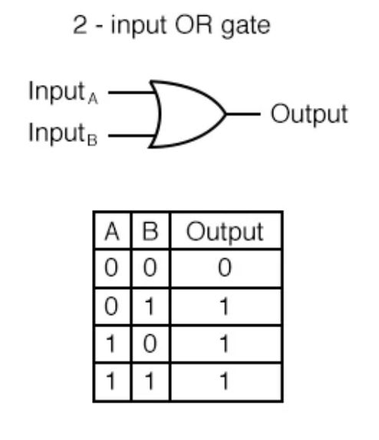
Copyright © 2014 Elsevier Inc. All rights reserved.

Slide 7
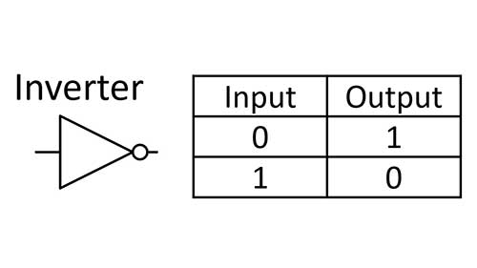
Copyright © 2014 Elsevier Inc. All rights reserved.

Slide 8

FIGURE B.2.2 Logic gate implementation of using explicit inverts on the left and bubbled inputs and outputs on the right. This logic function can be simplified to or in Verilog, A & ~ B.
8
Copyright © 2014 Elsevier Inc. All rights reserved.

Slide 9
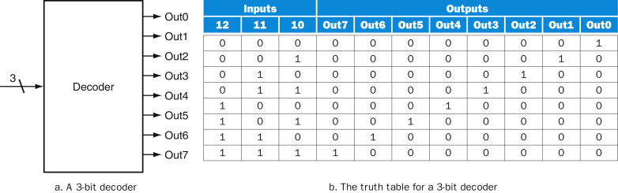
FIGURE B.3.1 A 3-bit decoder has 3 inputs, called 12, 11, and 10, and 2³ = 8 outputs, called Out0 to Out7. Only the output corresponding to the binary value of the input is true, as shown in the truth table. The label 3 on the input to the decoder says that the input signal is 3 bits wide.
9
Copyright © 2014 Elsevier Inc. All rights reserved.

Slide 10
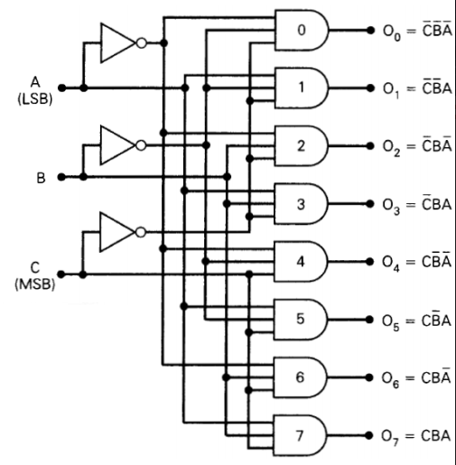
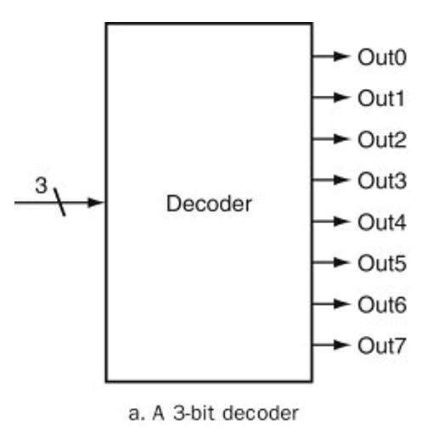
1
1
1
0
0
0
If CBA=000, then O₀=1, all other outputs=0
If CBA=001, then O₁=1, all other outputs=0
If CBA=010, then O₂=1, all other outputs=0
…… etc.

Slide 11
0
1
1
1
1
0
0
If CBA=000, then O₀=1, all other outputs=0
If CBA=001, then O₁=1, all other outputs=0
If CBA=010, then O₂=1, all other outputs=0
…… etc.

Slide 12
1
0
0
0
1
1
1
1
0
If CBA=000, then O₀=1, all other outputs=0
If CBA=001, then O₁=1, all other outputs=0
If CBA=010, then O₂=1, all other outputs=0
…… etc.

Slide 13
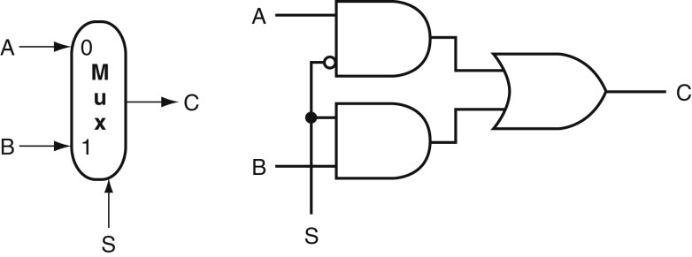
If S = 0, then C = A
If S = 1, then C = B
FIGURE B.3.2 A two-input multiplexor on the left and its implementation with gates on the right. The multiplexor has two data inputs (A and B), which are labeled 0 and 1, and one selector input (S), as well as an output C. Implementing multiplexors in Verilog requires a little more work, especially when they are wider than two inputs. We show how to do this beginning on page B-23.
13
Copyright © 2014 Elsevier Inc. All rights reserved.

Slide 14
1
A
0
= A
0
= 0
If S = 0, then C = A
FIGURE B.3.2 A two-input multiplexor on the left and its implementation with gates on the right. The multiplexor has two data inputs (A and B), which are labeled 0 and 1, and one selector input (S), as well as an output C. Implementing multiplexors in Verilog requires a little more work, especially when they are wider than two inputs. We show how to do this beginning on page B-23.
14
Copyright © 2014 Elsevier Inc. All rights reserved.

Slide 15
0
0
B
= B
1
= 1
If S = 1, then C = B
FIGURE B.3.2 A two-input multiplexor on the left and its implementation with gates on the right. The multiplexor has two data inputs (A and B), which are labeled 0 and 1, and one selector input (S), as well as an output C. Implementing multiplexors in Verilog requires a little more work, especially when they are wider than two inputs. We show how to do this beginning on page B-23.
15
Copyright © 2014 Elsevier Inc. All rights reserved.

Slide 16
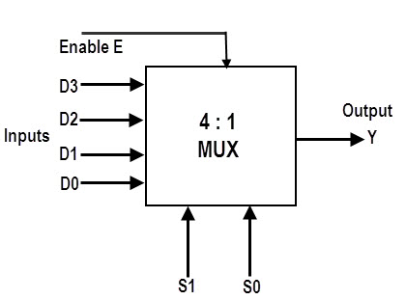
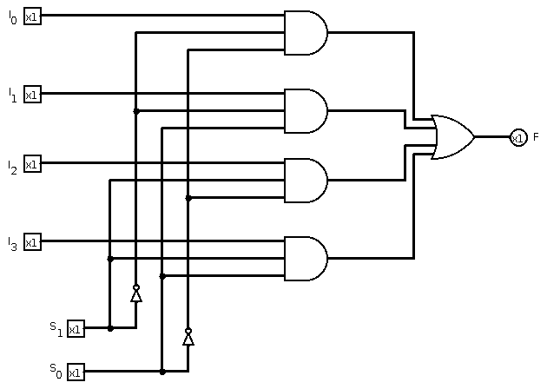
I₀
I₁
Y
I₂
I₃
Selection
Selection

Slide 17
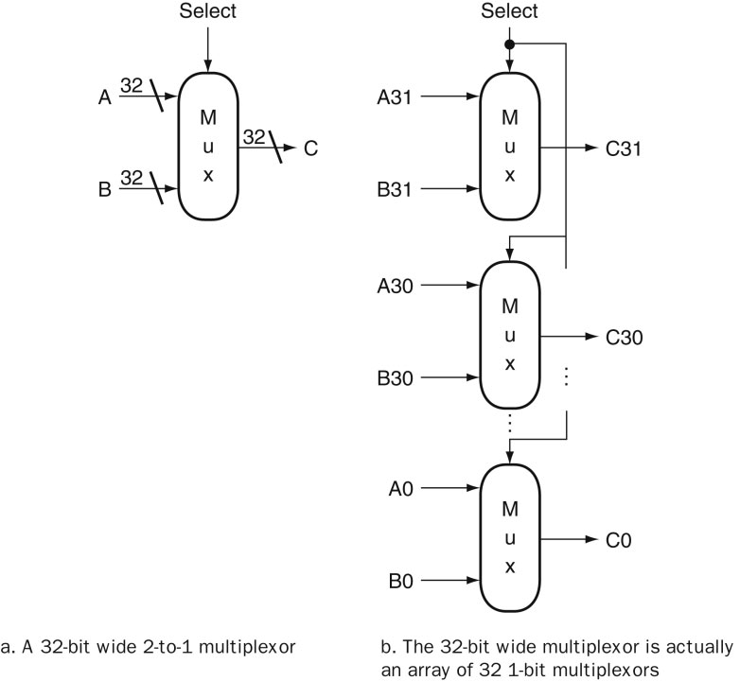
(1-bit)
(1-bit)
A31
A30
If S = 0, then C31C30…C0 = A31A30…A0
A0
FIGURE B.3.6 A multiplexor is arrayed 32 times to perform a selection between two 32-bit inputs. Note that there is still only one data selection signal used for all 32 1-bit multiplexors.
17
Copyright © 2014 Elsevier Inc. All rights reserved.

Slide 18
(1-bit)
(1-bit)
B31
If S = 1, then C31C30…C0 = B31B30…B0
B30
B0
FIGURE B.3.6 A multiplexor is arrayed 32 times to perform a selection between two 32-bit inputs. Note that there is still only one data selection signal used for all 32 1-bit multiplexors.
18
Copyright © 2014 Elsevier Inc. All rights reserved.

Slide 19
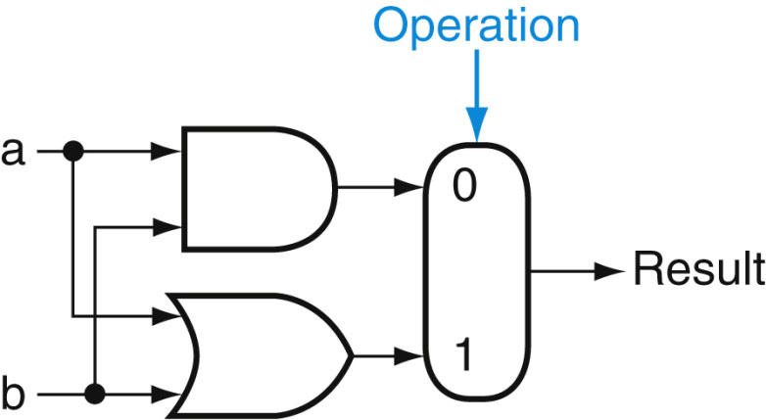
(1-bit)
a∧b
∧
a∨b
∨
Note: The Operation bit is actually a 1-bit instruction
FIGURE B.5.1 The 1-bit logical unit for AND and OR.
19
Copyright © 2014 Elsevier Inc. All rights reserved.

Slide 20
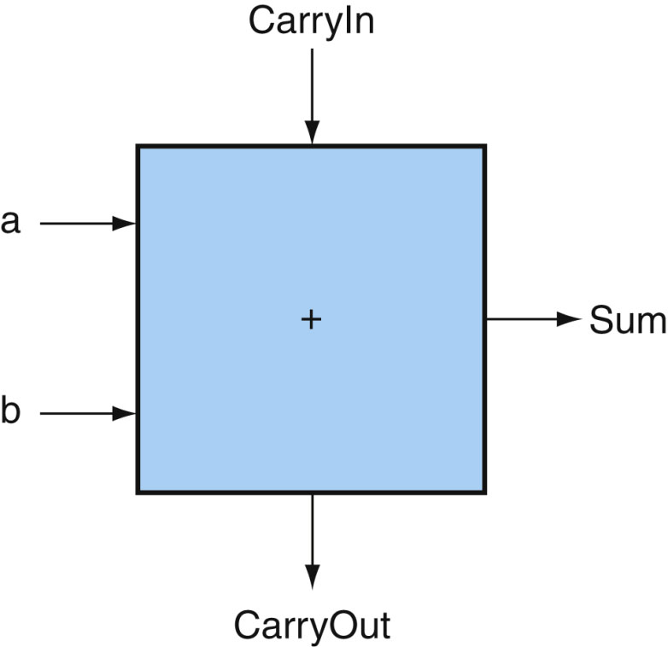
(a+b)
FIGURE B.5.2 A 1-bit adder. This adder is called a full adder; it is also called a (3,2) adder because it has 3 inputs and 2 outputs. An adder with only the a and b inputs is called a (2,2) adder or half-adder.
20
Copyright © 2014 Elsevier Inc. All rights reserved.

Slide 21
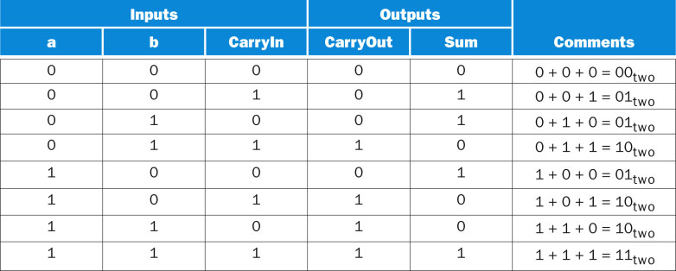
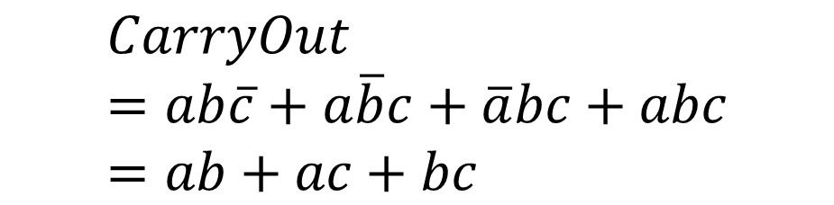
21
Copyright © 2014 Elsevier Inc. All rights reserved.

Slide 22
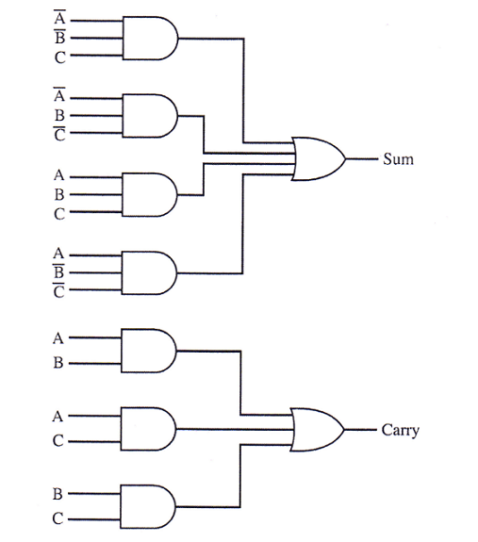


Slide 23
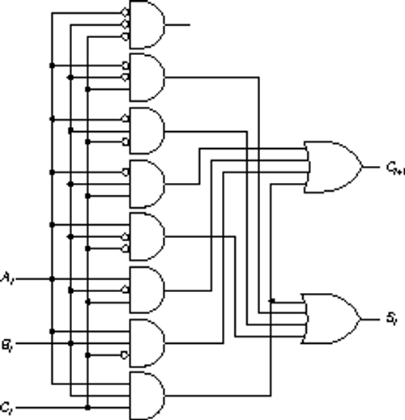


Slide 25
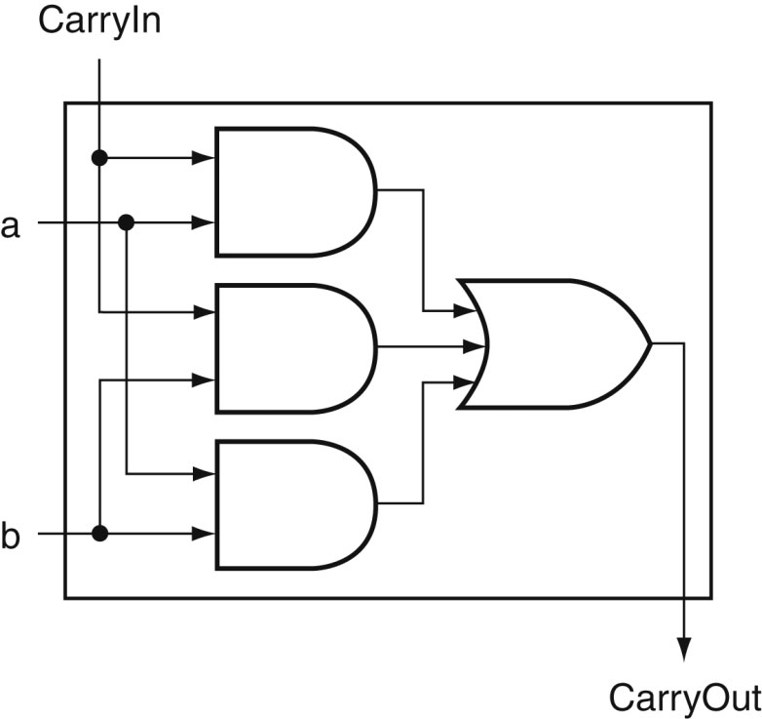
FIGURE B.5.5 Adder hardware for the CarryOut signal. The rest of the adder hardware is the logic for the Sum output given in the equation on this page.
25
Copyright © 2014 Elsevier Inc. All rights reserved.

Slide 26
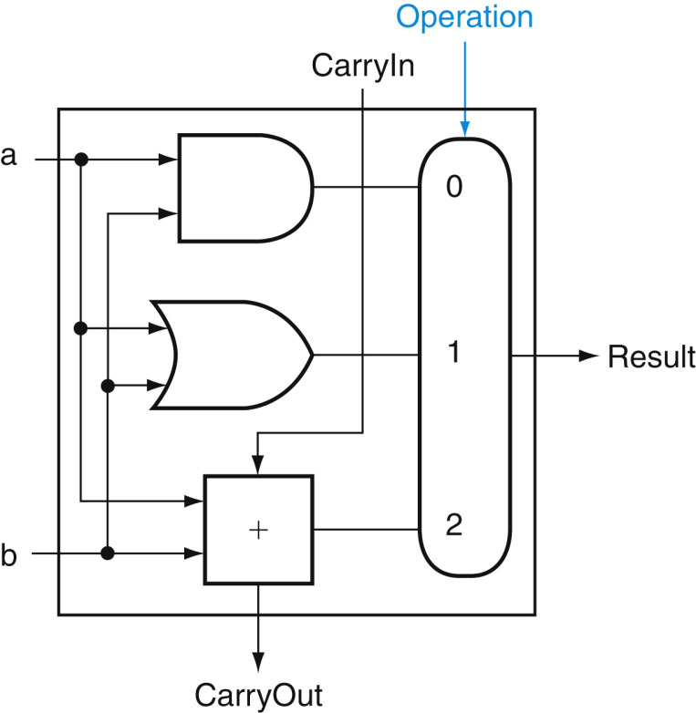
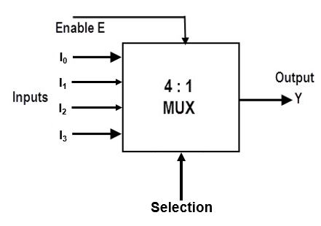
(2-bit)
(Result)
(Operation)
00: a ˄ b
= 01: a ˅ b
10: a + b
Operation:
2-bit instruction
FIGURE B.5.6 A 1-bit ALU that performs AND, OR, and addition (see Figure B.5.5).
26
Copyright © 2014 Elsevier Inc. All rights reserved.

Slide 27
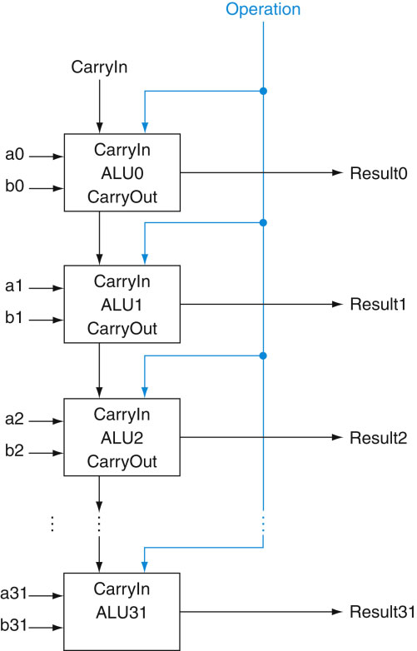
FIGURE B.5.7 A 32-bit ALU constructed from 32 1-bit ALUs. CarryOut of the less significant bit is connected to the CarryIn of the more significant bit. This organization is called ripple carry.
27
Copyright © 2014 Elsevier Inc. All rights reserved.

Slide 28
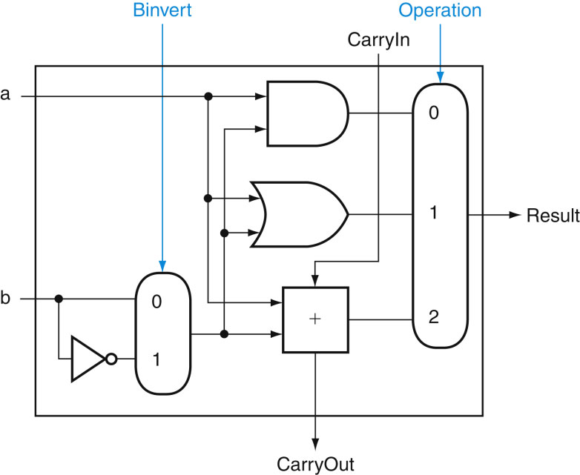
FIGURE B.5.8 A 1-bit ALU that performs AND, OR, and addition on a and b or a and b. By selecting (Binvert 5 1) and setting CarryIn to 1 in the least significant bit of the ALU, we get two’s complement subtraction of b from a instead of addition of b to a.
28
Copyright © 2014 Elsevier Inc. All rights reserved.

Slide 29
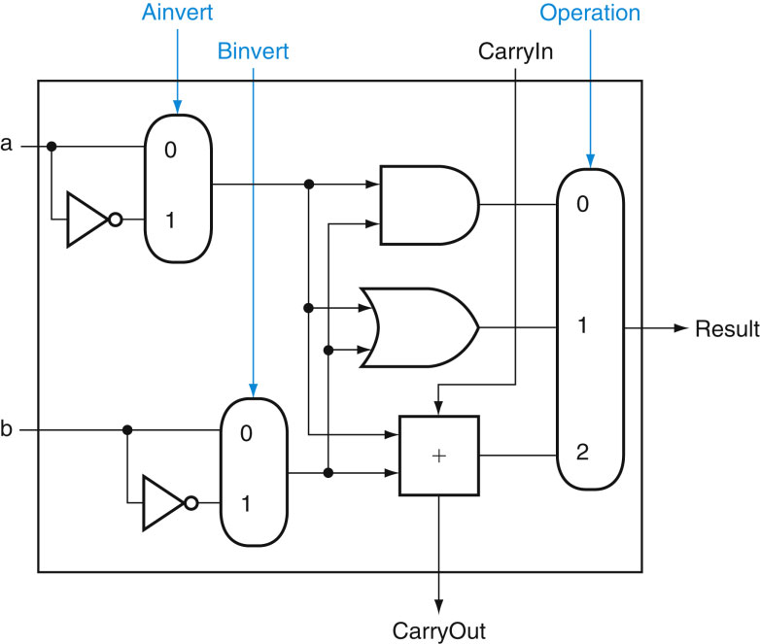
FIGURE B.5.9 A 1-bit ALU that performs AND, OR, and addition on a and b or a and b. By selecting (Ainvert 5 1) and (Binvert 5 1), we get a NOR b instead of a AND b.
29
Copyright © 2014 Elsevier Inc. All rights reserved.

Slide 30
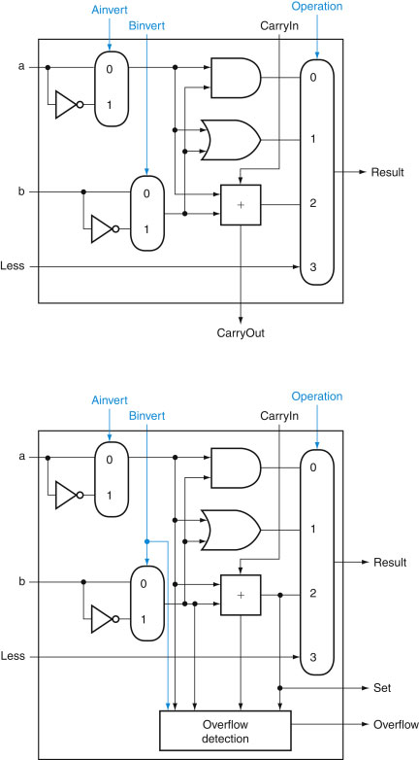
(bit31)
FIGURE B.5.10 (Top) A 1-bit ALU that performs AND, OR, and addition on a and b or b , and (bottom) a 1-bit ALU for the most significant bit. The top drawing includes a direct input that is connected to perform the set on less than operation (see Figure B.5.11); the bottom has a direct output from the adder for the less than comparison called Set. (See Exercise B.24 at the end of this appendix to see how to calculate overflow with fewer inputs.)
30
Copyright © 2014 Elsevier Inc. All rights reserved.

Slide 31
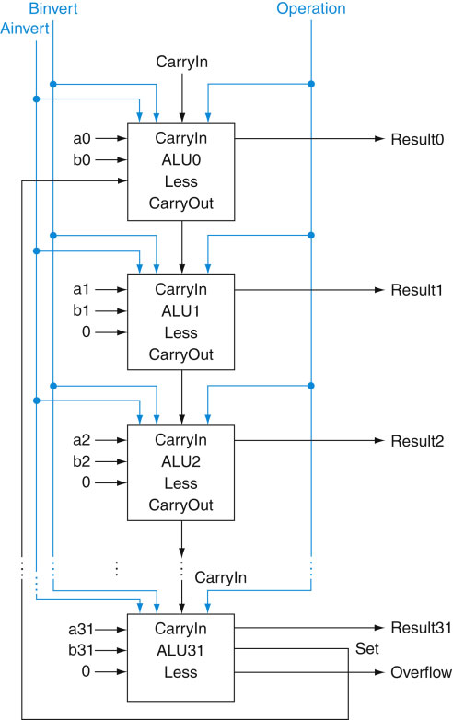
FIGURE B.5.11 A 32-bit ALU constructed from the 31 copies of the 1-bit ALU in the top of Figure B.5.10 and one 1-bit ALU in the bottom of that figure. The Less inputs are connected to 0 except for the least significant bit, which is connected to the Set output of the most significant bit. If the ALU performs a 2 b and we select the input 3 in the multiplexor in Figure B.5.10, then Result 5 0 … 001 if a , b, and Result 5 0 … 000 otherwise.
31
Copyright © 2014 Elsevier Inc. All rights reserved.

Slide 32
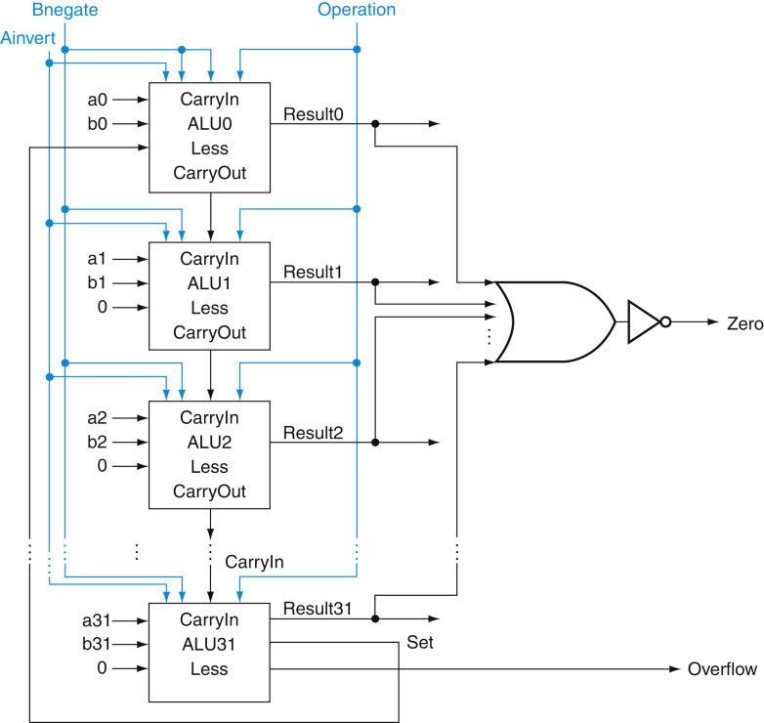
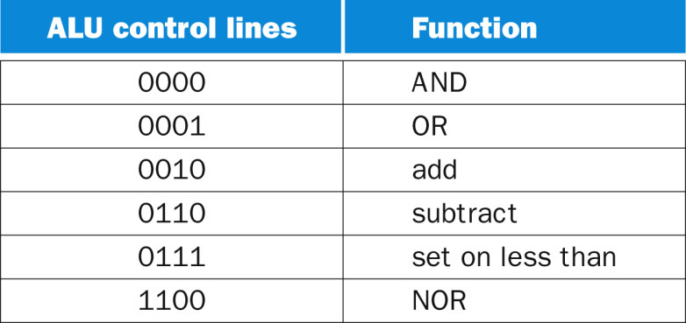
4-input mux
FIGURE B.5.12 The final 32-bit ALU. This adds a Zero detector to Figure B.5.11.
32
Copyright © 2014 Elsevier Inc. All rights reserved.

Slide 33
1
11
0
0/1
0
4-input mux
0
0
FIGURE B.5.12 The final 32-bit ALU. This adds a Zero detector to Figure B.5.11.
33
Copyright © 2014 Elsevier Inc. All rights reserved.

Slide 34
FIGURE B.5.13 The values of the three ALU control lines, Bnegate, and Operation, and the corresponding ALU operations.
34
Copyright © 2014 Elsevier Inc. All rights reserved.

Slide 35
ALU Operation: 4-bit instruction
FIGURE B.5.14 The symbol commonly used to represent an ALU, as shown in Figure B.5.12. This symbol is also used to represent an adder, so it is normally labeled either with ALU or Adder.
35
Copyright © 2014 Elsevier Inc. All rights reserved.

Slide 36
End

Slide 37
4
Out15
A 4-bit decoder
FIGURE B.3.1 A 3-bit decoder has 3 inputs, called 12, 11, and 10, and 2³ = 8 outputs, called Out0 to Out7. Only the output corresponding to the binary value of the input is true, as shown in the truth table. The label 3 on the input to the decoder says that the input signal is 3 bits wide.
37
Copyright © 2014 Elsevier Inc. All rights reserved.

